Slide 1
Extraction of Phenotypic Features via PubMed
李宁山
2018/1/5

Slide 2
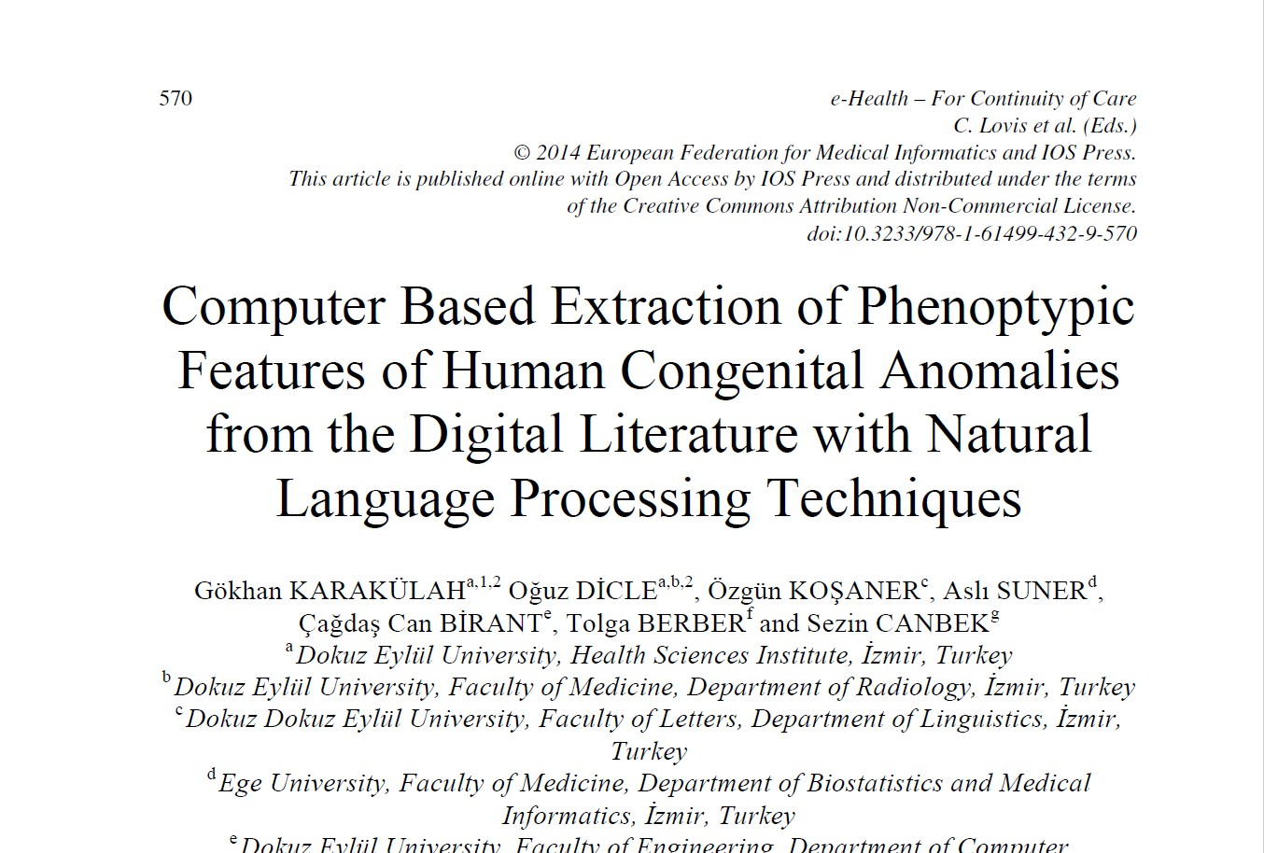
A 2014 Paper
KARAKüLAH G, DICLE O, KOŞANER Ö, et al. Computer Based Extraction of Phenoptypic Features of Human Congenital Anomalies from the Digital Literature with Natural Language Processing Techniques [J]. Studies in health technology and informatics, 2014, 205(570-4.

Slide 3
Human Congenital Anomalies (HCA)
High prevalence and mortality in newborns
Difficult to diagnosis
Requiring special expertise
Considering phenotypic features and rare symptoms
One HCA is distinct from other HCAs in terms of the related features
Need of clinical decision support systems

Slide 4
Authors' Work
Developing a computational strategy to extract the phenotypic features from the case reports in the literature via text processing and NLP methods
Creating an initial framework of an information base for diagnosis of HCAs using the extracted information

Slide 5
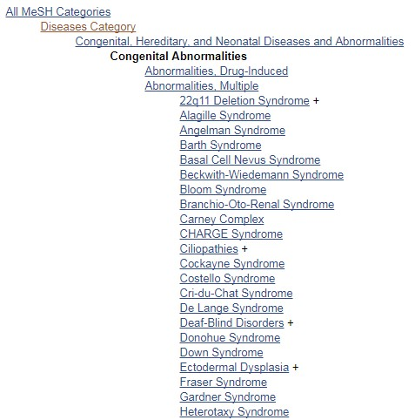
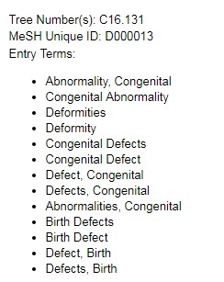
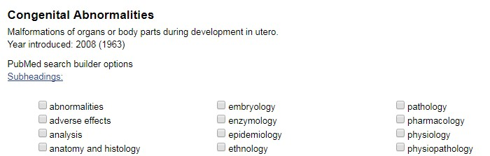
Step 1 Searching via Mesh in PubMed
Medical Subject Headings (MeSH)

Slide 6
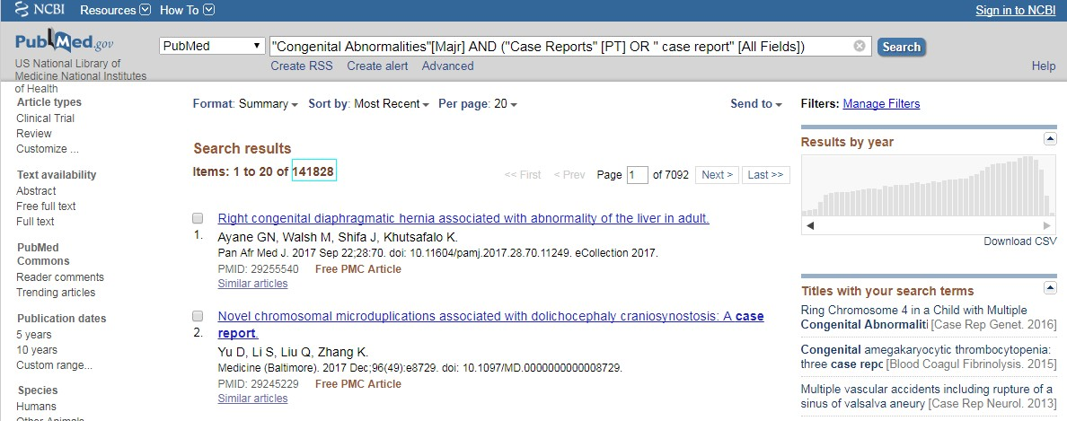
Step 1 Searching via Mesh in PubMed
"Congenital Abnormalities"[Majr] AND ("Case Reports" [PT] OR " case report" [All Fields])

Slide 7
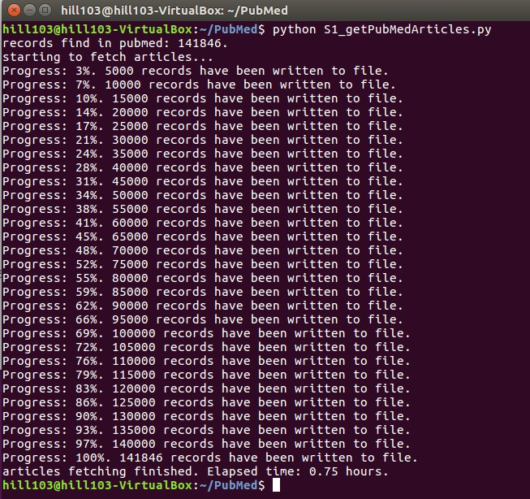
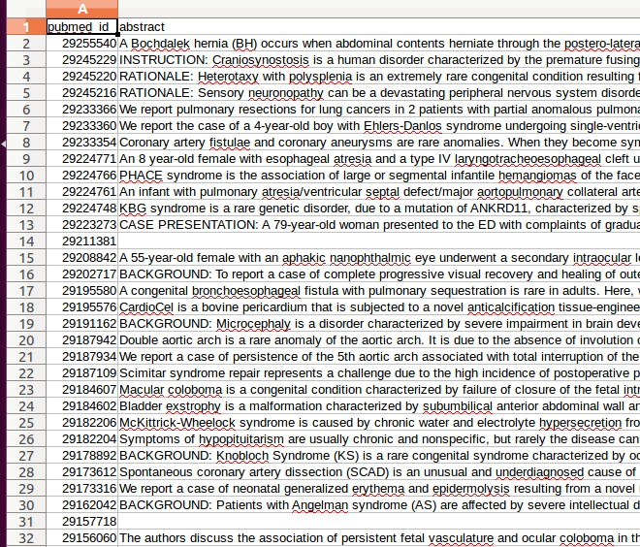
Step 2 Download Abstracts using Biopython

Slide 8
Future Work
Step 2 Download Abstracts
Step 3 NLP
Step 4 HPO matching
Step 5 N-gram analysis for phrase patterns and verbs

Slide 9
Cause of Matching Failure
the feature mentioned in the document did not have correspondence in the terms list in the HPO
the differences in word morphology caused mismatches
due to the abbreviated writing of terms in the documents

